Slide 1

Department of Information Technology​ ​
Major Project
​
AUTOMATIC EYE DISEASE DETECTION USING MACHINE LEARNING
Presented by: Batch - 13 Guided by
Devila Tharun Kumar - 20N31A1251 T.Shilpa
B.Bhargav - 20N31A1235 ( Assistant Professor)
B.Jhansi - 20N31A1228

Slide 2
AGENDA
Abstract
Introduction
- Purpose of the Project
- Existing and Proposed System
- Scope of the Project
System Analysis
- Hardware and Software Requirements
System Design
- Architecture
- UML Diagrams
References

Slide 3
ABSTRACT
Inherited retinal diseases (IRDs) pose a significant threat to childhood vision, often leading to severe visual deficits and blindness. Diagnosing these conditions is a complex challenge due to the multitude of clinical and genetic factors involved, encompassing over 200 causative genes. Traditional diagnostic methods, including invasive tests, are not always suitable for infants and young children. This paper introduces a pioneering approach to pediatric IRD diagnosis, leveraging Chromatic Pupillometry, a technique increasingly utilized for assessing both outer and inner retina functions.
The proposed solution involves a unique Clinical Decision Support System (CDSS) that integrates hardware and software components. A specialized medical device, a pupillometer, is employed in conjunction with a custom-designed machine learning system. Two distinct Support Vector Machines (SVMs), one for each eye, analyze features extracted from pupillometric data to classify and diagnose IRDs. The CDSS has been specifically applied to the diagnosis of Retinitis Pigmentosa in pediatric subjects.
The results demonstrate the efficacy of the system, with an ensemble model combining the outputs of the two SVMs achieving a commendable accuracy of 0.846, sensitivity of 0.937, and specificity of 0.786. This study marks a groundbreaking application of machine learning to pupillometric data, offering a promising alternative for the accurate and non-invasive diagnosis of genetic diseases in pediatric populations.

Slide 4
INTRODUCTION
Inherited Retinal Diseases (IRDs) pose a significant threat to children's vision, often leading to severe visual impairments and, in many cases, blindness during childhood in Established Market Economies (1 in 3000 individuals). These conditions can be broadly categorized into diseases affecting the outer retina, such as photoreceptor degenerations (examples include Leber Congenital Amaurosis, Retinitis Pigmentosa, Stargardt disease, Cone Dystrophy, Acromatopsia, Choroideremia, etc.), and diseases impacting the inner retina, predominantly involving retinal ganglion cell degeneration (examples include congenital glaucoma, dominant optic atrophy, Leber hereditary optic neuropathy).
A significant challenge in addressing these conditions lies in their remarkable genetic heterogeneity, with over 200 causative genes identified to date. This diversity complicates the swift and effective diagnosis of IRDs, further compounded by the fact that the same gene can give rise to various and heterogeneous clinical phenotypes. As a result, navigating this complexity becomes crucial for developing targeted therapeutic approaches and improving the outcomes for individuals affected by IRDs.

Slide 5
Existing System:
Complex Diagnosis Process: Clinical evaluation of Inherited Retinal Diseases (IRDs) involves a complex pattern of tests, including invasive ones, making it challenging for infants and young children.
Sedation Dependency: Electrophysiological testing, crucial for diagnosis, often requires sedation for children, affecting retinal responses and demanding a high-cost healthcare environment.
Limited Accessibility: Specialized centers are essential for accurate diagnosis, resulting in delays for young patients and their families to receive a complete screening.
Time-Consuming: The entire diagnostic process is time-consuming due to the complexity and the need for specialized centers, causing anxiety for patients and their relatives.
Monitoring Challenges: Electrophysiological responses, especially when below the noise level, are not suitable for effectively monitoring changes in visual functionality, hindering accurate assessment of disease progression and therapy efficacy.

Slide 6
Proposed System:
Non-Invasive Diagnosis for Pediatric Eye Diseases: The proposed system utilizes Pupillometry, a non-invasive method, to capture continuous pupil diameter data. This eliminates the need for extensive and potentially harmful clinical tests, making it safer and more comfortable for pediatric patients.
Reduced Testing Burden on Children: Unlike existing techniques that may require numerous clinical tests, the proposed system streamlines the diagnostic process. By continuously monitoring and recording pupil diameters using the Pupillometry device, it minimizes the burden of testing on children, enhancing their overall healthcare experience.
Efficient Machine Learning Classification: The integration of Support Vector Machine (SVM) algorithms allows for efficient training and classification of right and left eye pupil data. This not only enables the system to identify abnormal pupil sizes but also contributes to the overall accuracy of disease detection in pediatric patients.
Ensemble Voting for Enhanced Accuracy: The use of Ensemble Voting Classifier combines the outputs of two separate SVM classifiers for the right and left eyes. By employing an OR operation, the system benefits from the strengths of both classifiers, ultimately achieving a higher accuracy rate of 84.6%. This ensemble approach enhances the reliability of the diagnostic outcome.

Slide 7
Scope of the Project:
The scope of the face detection unlocking system project is comprehensive, encompassing key aspects from system design to ongoing management.
This endeavour entails delineating the system's blueprint, opting for a sophisticated facial Recognition algorithm, and crafting an interface.
It involves defining architecture, the deployment plan is phased to minimise distributions, and ongoing maintenance, support and compliance monitoring are integral components.
This project emphasises compliance with data protection regulations, industry standards, and implementation of monitoring and auditing process to track performance and generate access activity report. This comprehensive approach ensures the successful implementation and sustainable operation of the face detection unlocking system.

Slide 8
SYSTEM ANALYSIS
Hardware Requirements:
Processor: i3 Minimum
Ram: 4 GB Minimum
Hard Disk: 250 GB Minimum
Software Requirements:
Operating System: Windows
Programming Language: Python 3.7
Python Packages:
-keras==2.3.1
-numpy==1.19.2
-Matplotlib==3.1.1
- pandas==0.25.2
- scikit-learn==0.22.2.post1
- tensorflow==1.14.0

Slide 9
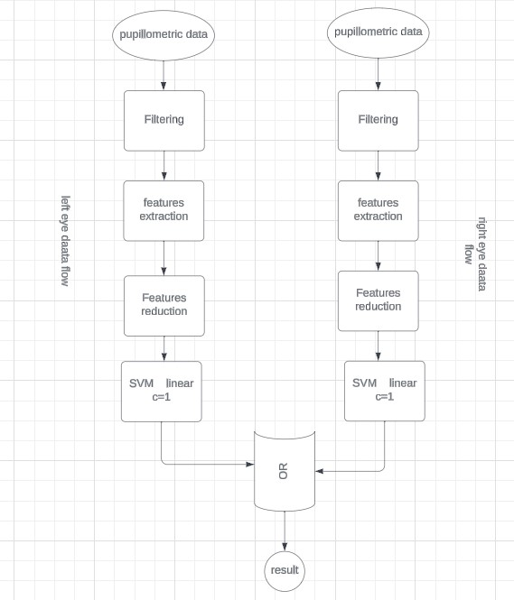
SYSTEM DESIGN
Architecture:

Slide 10
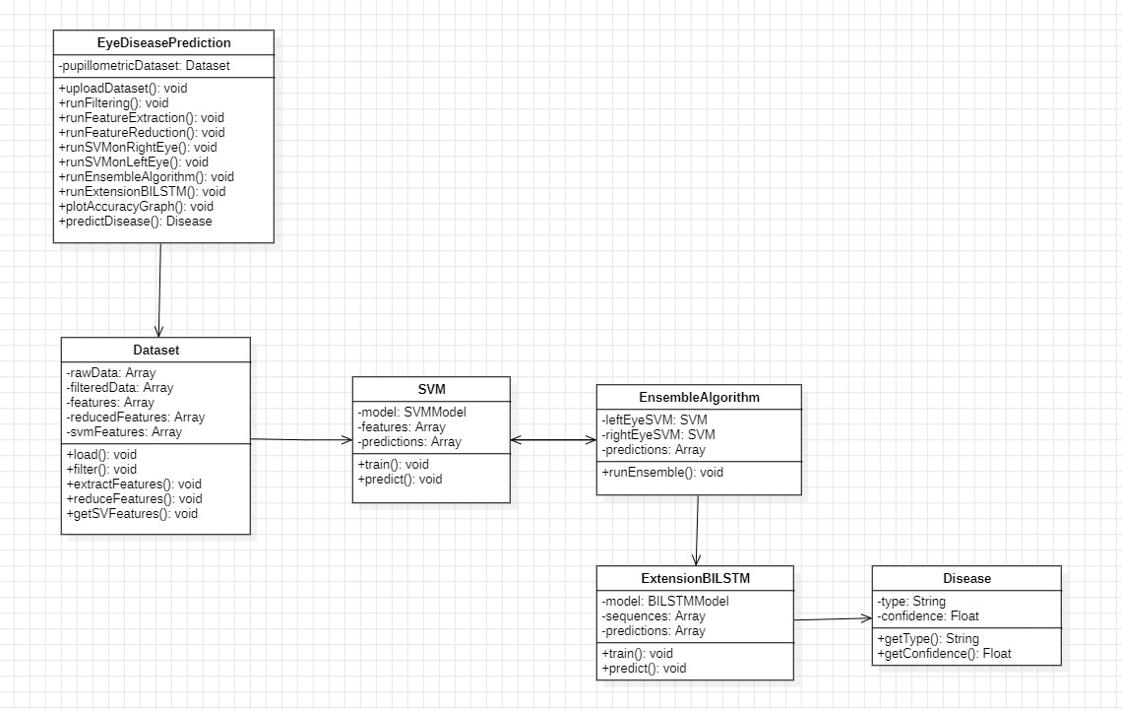
UML Diagrams: class daigram

Slide 11
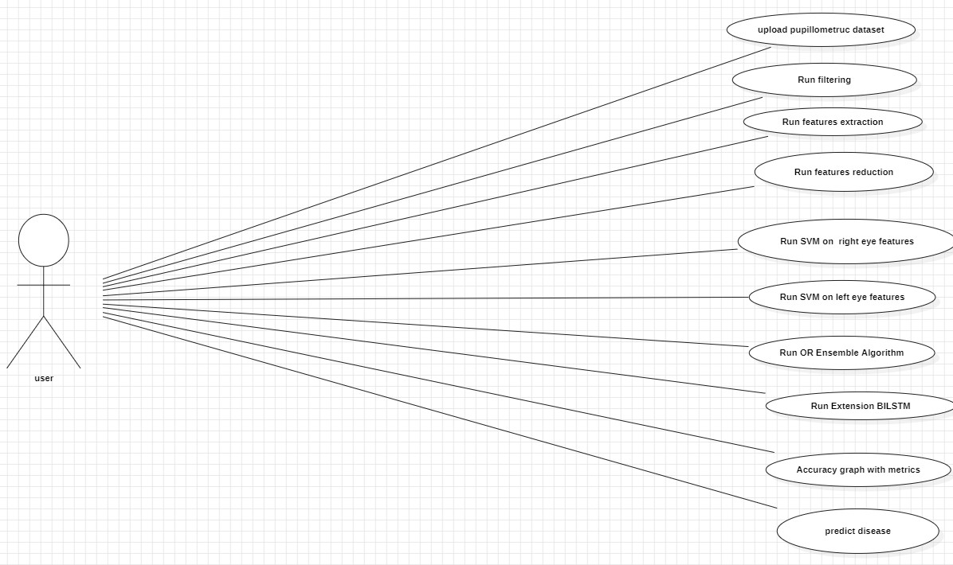
Use Case Diagram:

Slide 12
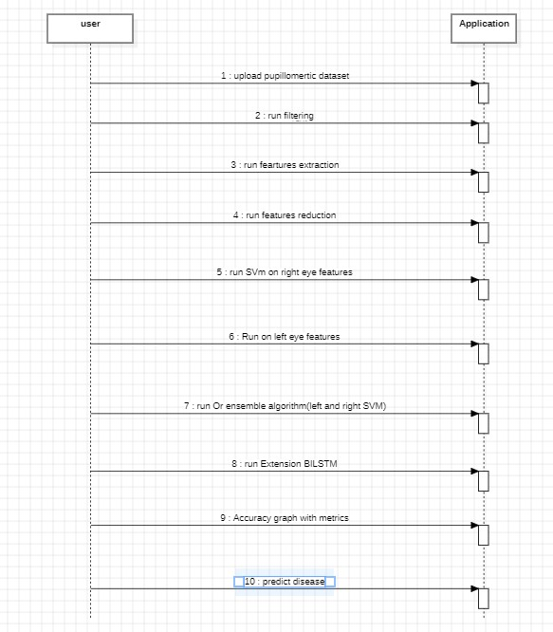
sequence daigram

Slide 13
REFERENCES
[1]. Acharya, U. R., Kannathal, N., Ng, E. Y. K., Min, L. C., & Suri, J. S. (2006, August), Computer-based classification of eye
diseasesIn Engineering in Medicine and Biology Society, 2006. EMBS'06. 28th Annual International Conference of the IEEE (pp.6121-6124). IEEE.
[2]. Gardner, G. G., Keating, D., Williamson, T. H., & Elliott, A. T. (1996), Automatic detection of diabetic retinopathy using anartificial neural network: a screening toolBritish journal of Ophthalmology, 80(11), 940- 944.
[3]. Winder, R. J., Morrow, P. J., McRitchie, I. N., Bailie, J. R., & Hart, P. M. (2009), Algorithms for digital image processing indiabetic retinopathyComputerized medical imaging and graphics, 33(8), 608-622.
[4]. Ibrahim, F., Ali, J. B., Jaais, A. F., & Taib, M. N. (2001), Expert system for early diagnosis of eye diseases infecting theMalaysian population In TENCON 2001. Proceedings of IEEE Region 10 International Conference on Electrical and Electronic Technology (Vol. 1, pp. 430-432). IEEE.
[5]. Bock, R., Meier, J., Michelson, G., Nyúl, L. G., & Hornegger, J. (2007, September), Classifying glaucoma with image-basedfeatures from fundus photographsIn Joint Pattern Recognition Symposium (pp. 355-364). Springer, Berlin, Heidelberg.

